Slide 1

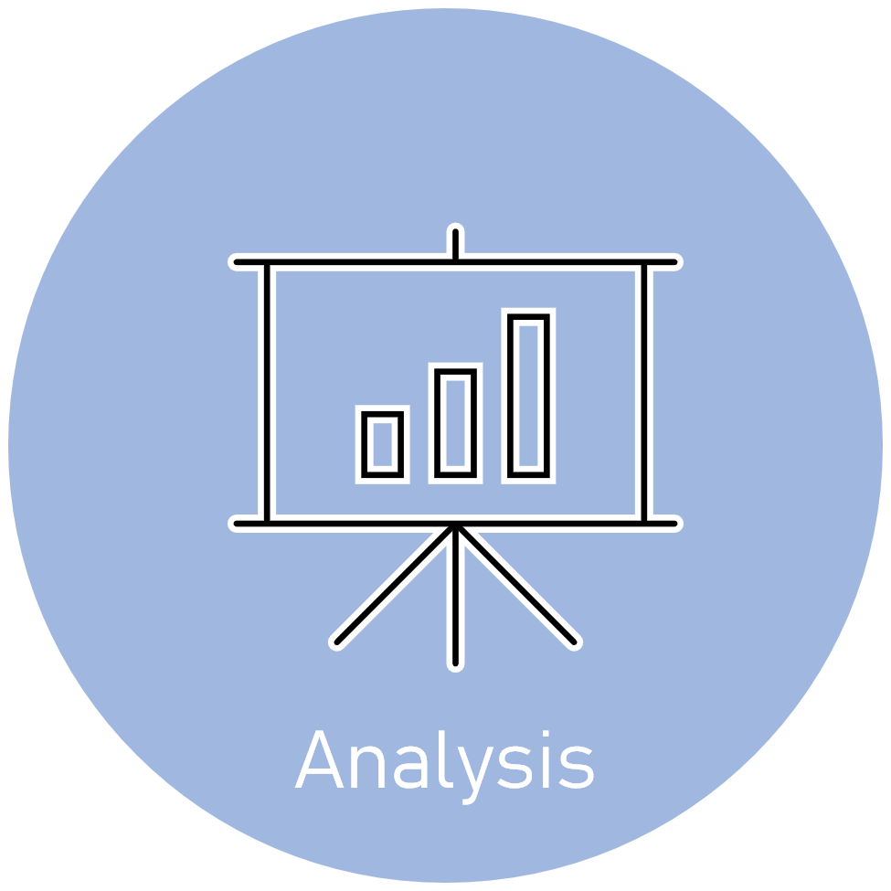




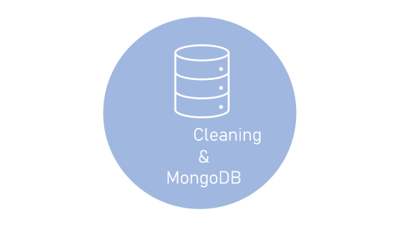

Slide 2

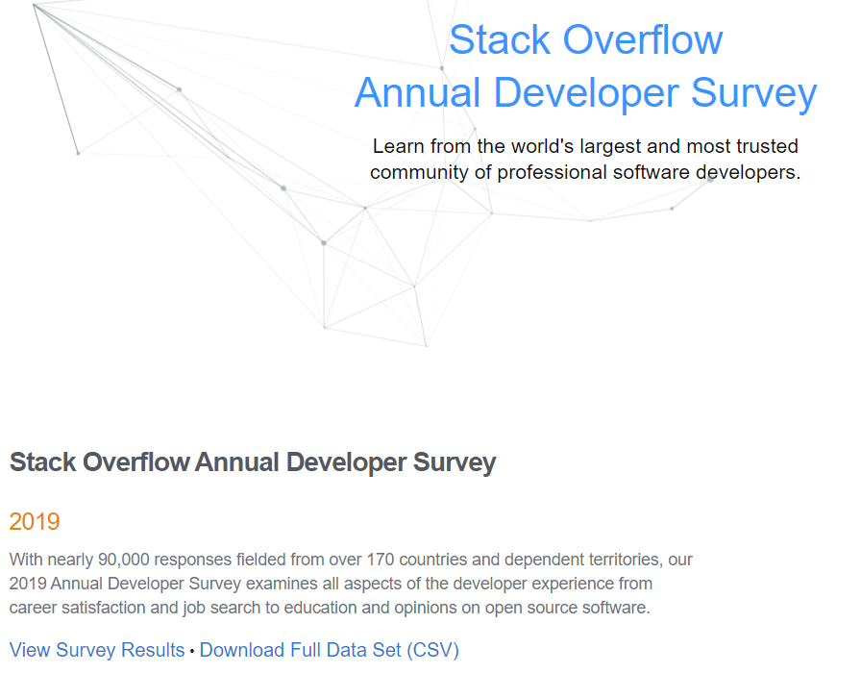



Motivation
Developer Survey is collected from over 80K respondents throughout 2019

Slide 3
Now What?
What languages are most demanded in my domain?
Are my skills sufficient for the jobs I’m pursuing?
What else should I learn?
What are the salary ranges in my domain?
Are people who work in my domain satisfied with their jobs?

Slide 4

Data
Preparation
Developer Survey is collected from over 80K respondents throughout 2019

Slide 5
Data
Preparation
Developer Survey is collected from over 80K respondents throughout 2019

Slide 6

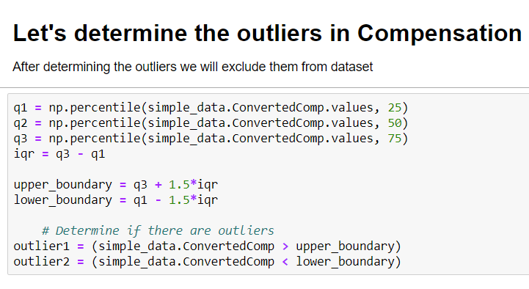
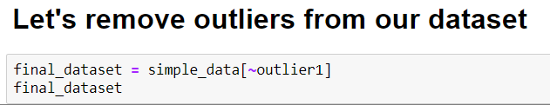
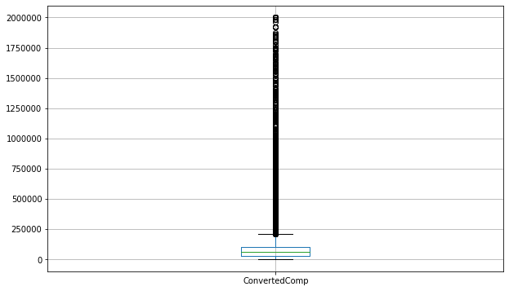
Data
Cleaning
&
MongoDB

Slide 7
Data
Cleaning
&
MongoDB
The dataset was mostly clean but still required some manipulation. The dataset had lots of information that can be used for different types of analysis.

Slide 8



CODING

Slide 9
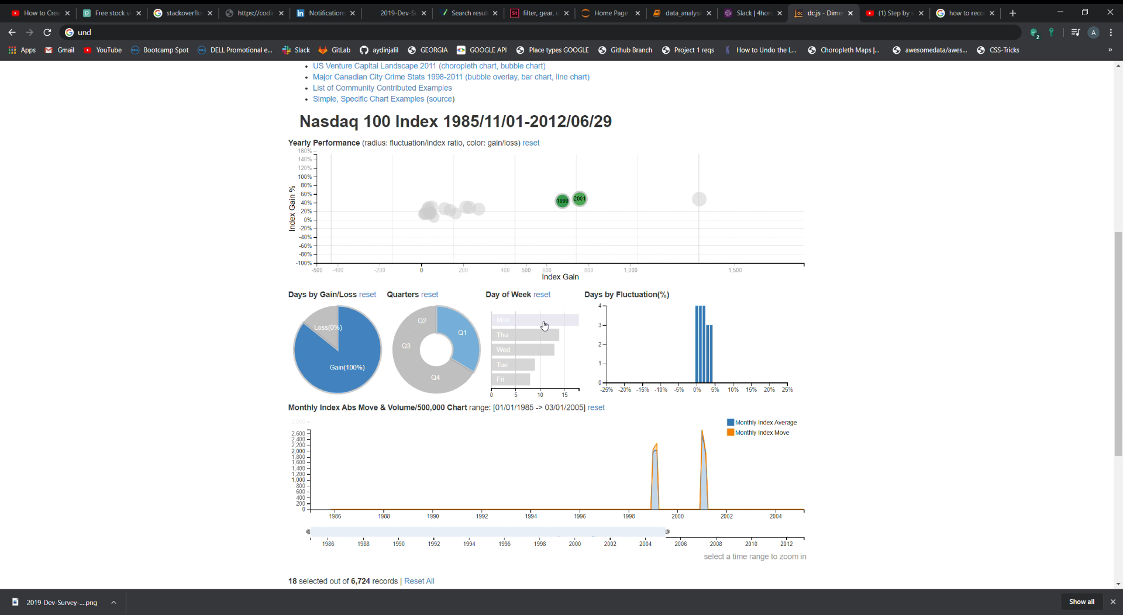
Why?
The project exploited DC.js
Library of Javascript for its
ability to work efficiently with large dimensional datasets and its native support of Crossfilter.
Note: The visualization on the right-hand side of the window
Does not represent the current project but a video recorded from open source for demonstration purposes.

Slide 10
Pros
Great data visualization.
Performs graphical filtering.
Fast creation of charts and dashboards.
Creation of highly interactive dashboards.
Cons
Extremely buggy.
Lots of workarounds even for the simplest tasks.
Many conflicting solutions.

Slide 11



Analysis

Slide 12
What?
This project was aimed at building interactive charts showing the relationships between Development Type, Programming Languages used, Compensation of respondents (converted to USD), and Job Satisfaction.

Slide 13
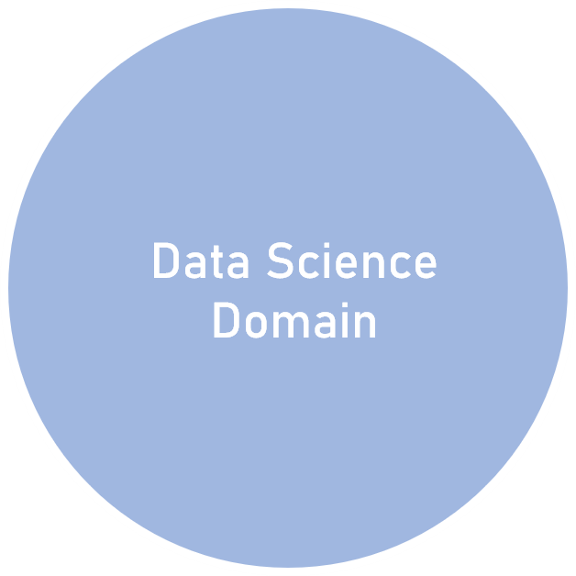
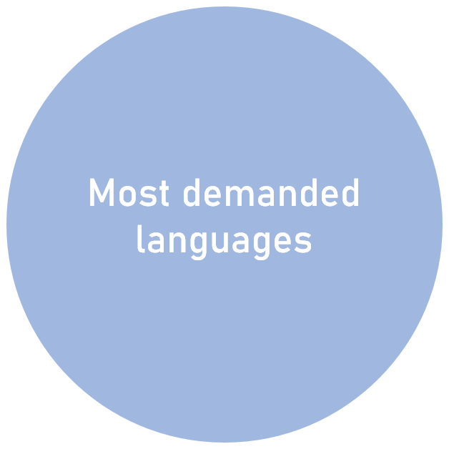
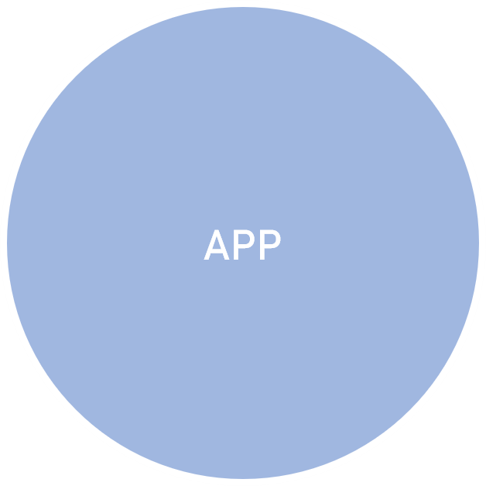

Slide 14
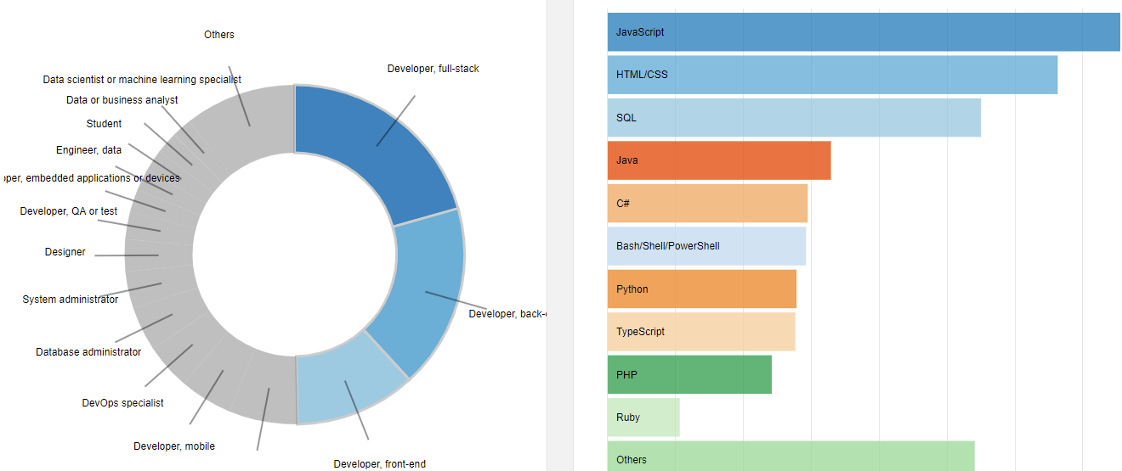
Most demanded languages per Domain
The charts can be filtered based on by clicking on its parts. The image on the right shows most demanded languages in Back-end, Front-end and Full-stack development combined

Slide 15
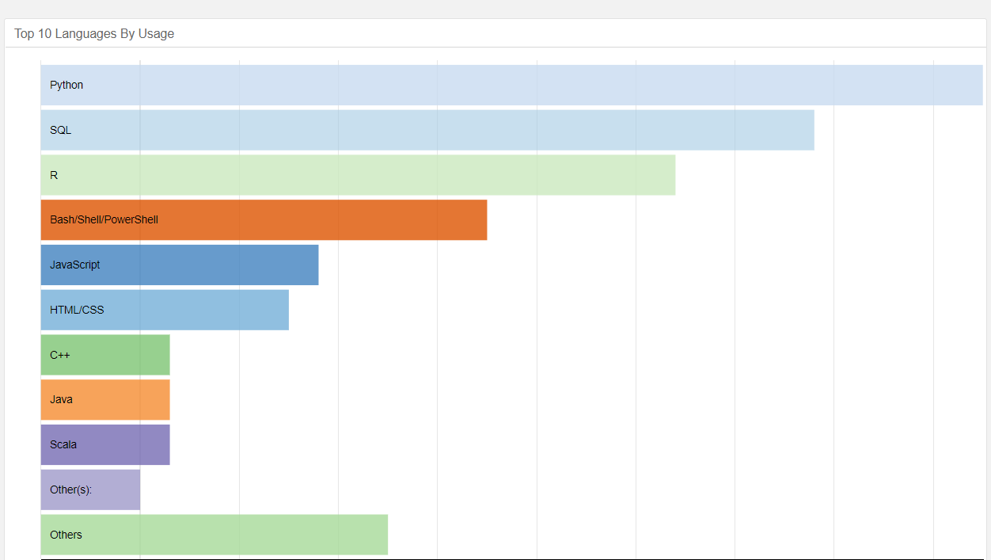
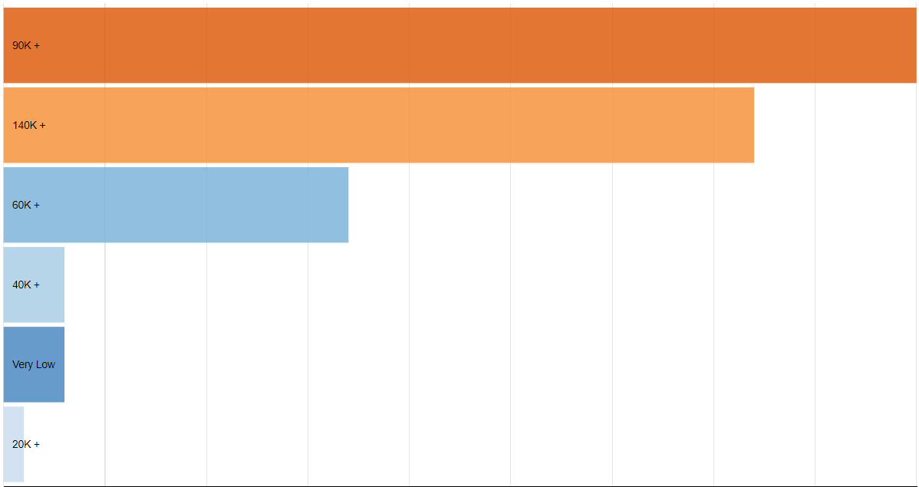
Languages in demand for Data Scientists and most common salary ranges in US.
The charts show that the Python, SQL and R are top 3 languages in Data Science Domain followed by Bash, JavaScript and HTML/CSS. Some of Data Scientists happen to know C++ and Java.
Most common salary range for Data Scientist position is 90+ which goes up to 140K included followed by 140K+.

Slide 16
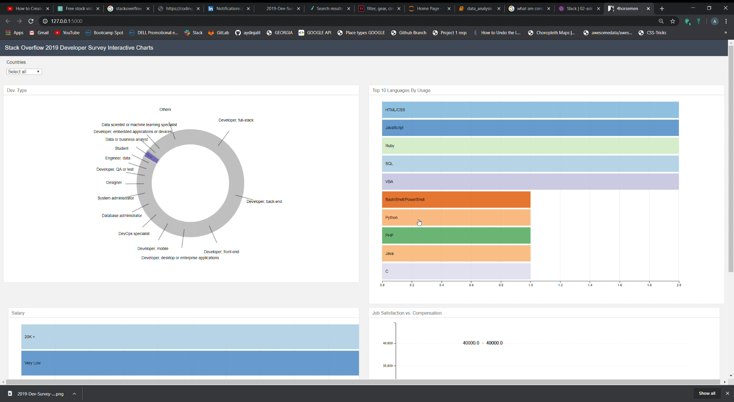
Results?
The resulting tool is visually pleasing and easy to use. By clicking on specific parts of the charts, the user can get an idea on which languages are most popular in a specific domain, as well as the most common salary ran. Information about job satisfaction relative to the compensation is made available to user in a boxplot chart. All of this can be filtered by country which is a drop-down menu.

